Slide 1
Predicting Results of English Premier League Matches using Data Mining
University of Massachusetts Dartmouth
CIS 602-01 Data Mining Project
Tu Luong, Hai Ha, Minh Nguyen

Slide 2
Outline
Introduction
Related Work
Problem Definition
Methodology
Experimental Setting
Experimental Results and Analysis
Further Work
Conclusion

Slide 3
Introduction
Predicting results of soccer matches in English Premier League (EPL)
Classification - Each match - Win, draw, lose ( [0, 1, 2]) - Algorithms: SVM, KNN
Modelling samples
Notes:
1. In this project, we use methods of machine learning to predict result of soccer matches in English Premier League.
- Problem can be considered as Classification for each match with label of 0,1,2 represent the win, draw, lose
- Algorithms can be used are: SVM, KNN, random forest. those are already implement in previous assignment.
- Our aim is building model of samples with different classifiers are tested to attempt solving the problem.

Slide 4
Related Work
Paper from Stanford University by Ben Ulmer, and Matthew Fernandez [2] - 5 different classifiers: Linear, Naive Bayes, Hidden Markov Model, SVM, and Random Forest. - Best accuracy: Linear classifier 52% Random Forest 50% SVM 50%
Paper from Saint-Petersburg State University by Albina Yezus [3] - KNN, Random Forest, Logistic Regression, and SVM - 55.8% success rate in KNN and another 63.4% in Random Forest
Notes:
1. Most of the work have been done by famous gambling companies for the benefit of odds-makers.
2. However, there are also several groups have taken to the predicting game as well.
Focused on improving hyper parameters and class imbalance, thus their approach is using grid searches and ROC curve analysis respectively.
Both papers explored several methods and found neural networks to generate the most successful.

Slide 5
Dataset Introduction
EPL Dataset background: - 20 best soccer teams in England and Wales. - Each team will play against each other team twice (at home and when away, total 380 matches). - Win: 3 points, draw: 1 point, lose: 0 point. - Team with most points win the league.

Slide 6
Problem Definition
Extract features from original data
Key Features | Definition
Team Form | The last 10 games / team
History Head-to-Head | One previous result between two teams
Score Difference | Score of two teams in the previous head-to-head match
Motivation | Team’s motivation in particular match
Concentration | Level of concentration for each club in particular match
Home Team Winning Ratio | Winning ratio of home team in all previous matches playing at home
Away Team Winning Ratio | Winning ratio of away team in all previous matches playing away

Slide 7
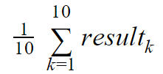


Methodology
All features will be normalized [0, 1]
Team form:
History head-to-head: {0, 0.5, 1}
Score difference:
Motivation:
Notes:
resultk is the outcome from kth match, and its value lies in {0, 0.5, 1}
This feature simply returns result in {0, 0.5, 1}
- homeGoal: number of goals scored by home team - awayGoal: number of goals scored by away team
- dist: distance to the nearest key position (position in {1, 2, 3, 4, 5, 6, 17, 18}) - derby: if this match is derby match, return 1, otherwise, return 0 - tour: return 1 if there are less than 6 matches left, 0 otherwise - left: matches left in the season of this team

Slide 8
Methodology
Concentration:
if played matches are less than 6 return 1 for both weak and strong team
if played matches > 6 and difference between teams position is < 7 return 1 for weak team, and 1 / diff for stronger team
if played matches > 6 and difference between teams position is > 7 return 1 for weak team, and 1 / 7 for stronger team
Home team winning ratio: [0, 1]
Away team winning ratio: [0, 1]
Notes:
By this way, the closer the two teams are, the more concentrated the stronger team is.

Slide 9
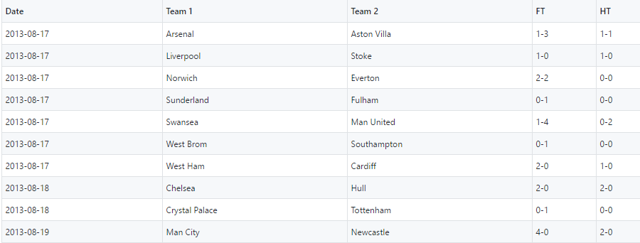
Experimental Setting
JavaScript: d3.js (https://github.com/d3/d3)

Slide 10
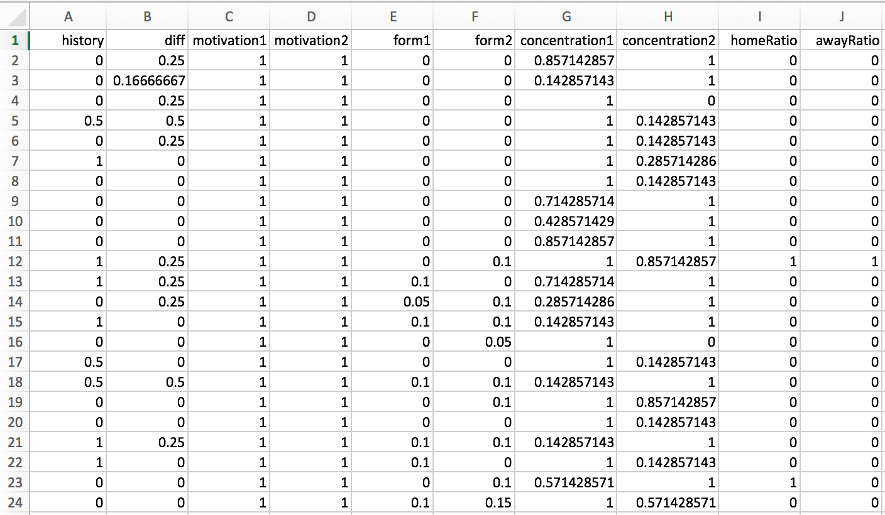
Experimental Setting
MatLab:
Notes:
After using js to extract features, using all formulas as we mentioned before. we have all samples with those features represent for each match to put into matlab.
Bcs many things change after each season so we use within saeson data to train model.
In total we have 380 samples for both training and testing data.As you can see for the first several rounds, we consider each team with full mov as 1. And home and away ratio will be 0

Slide 11
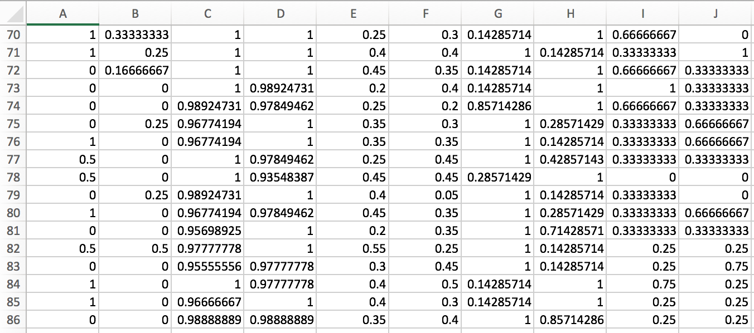
Experimental Setting
Notes:
Here is the data after that. Looks more crazy.

Slide 12
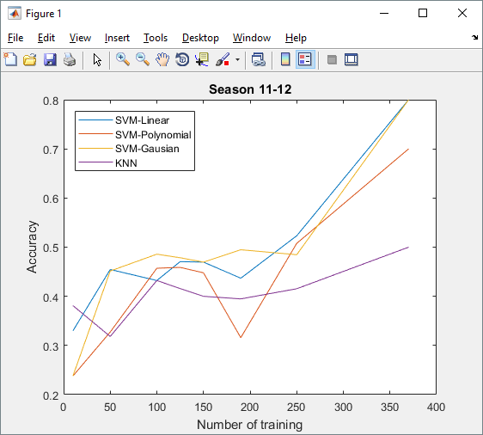
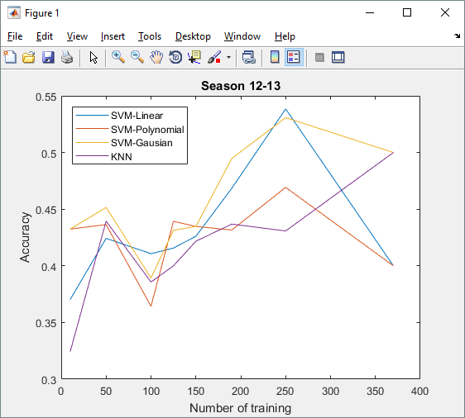
Experimental Results and Analysis

Slide 13
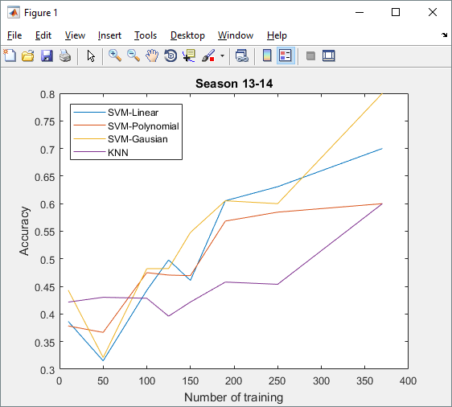
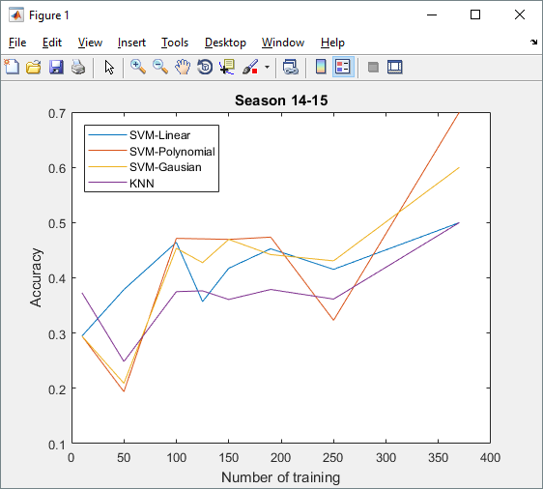
Experimental Results and Analysis

Slide 14
Experimental Results and Analysis
Notes:
Even Though we use the same method, same code for all seasons but the acc are quite diff between seasons.
Some have really good but some have not that good.
Most of season has same trend of graph: increase num of training also increases accuracy. But for ss 12-13, the result is fluctuating and unpredictable.
The highest acc for last 10 rounds is around 0.7-0.8 but only ss 12-13 is 0.5
The acc for SVM with gaussian kernel usually higher and more stable than others.
The most unstable is SVM with poly kernel

Slide 15
Conclusion & Further Work
Features extraction is crucial to prediction accuracy.
We use KNN, and SVM to classify, the results is quite promising (approx. 61% comparing to 33.33% randomly).
In the future, improving features formula and collect more data.
It may have a broader applicability for many different kinds of sports.
Providing data analytics for football club managers, players, head-hunters, sports critics, etc.
Notes:
Approx 61 … with using first half of Season as training data ...
In the future, we want to increase the number of features which have significant effect to a match to improve outcome accuracy. To do that, we need collecting more data and improving each feature formula. If we can eliminate one possible outcome for a specific match (e.g. a match has possibility of drawing, home winning, home losing is very low), then we can improve the accuracy of that match.
By using the prediction, we could turn soccer community into more interesting field.
We could - Benefit entertainment areas. - Raising fund that concentrates from sport betting.

Slide 16
References
[1] Rue, Harvard, and Oyvind Salvesen, “Prediction and retrospective analysis of soccer matches in a league” Journal of the Royal Statistical Society: Series D (The Statistician) 49.3 (2000): 399-418. [2] Ulmer, Ben and Matthew Fernandez, “Predicting Soccer Match Results in the English Premier League.” (2014). [3] Yezus, Albina, “Predicting Outcome of Soccer Match using Machine Learning”. (2014). [4] Predicting the outcome of NFL games using machine learning, Babak Hamadani, cs229 - Stanford University (2006) [5] Numerical Algorithms for Predicting Sports Results by Jack David Blundell, School of Computing, Faculty of Engineering (2009)

Slide 17
Thank you !!

